Slide 1
M3: Getting paid
Presentations, Empowerment and Billing

Slide 2
Objectives and Agenda
Objectives:
Practice delivering engaging presentations and providing constructive feedback
Study content related to coding and billing of dietetics/nutrition services to obtain reimbursement for services from public or private insurers
Describe methods nutrition professionals may use in the future to help expand employment opportunities in dietetics, improve primary medical care, and reduce US health care costs
Agenda:
Deliver resource presentations
Re-Cap/Questions
Review and practice the empowerment approach
Study content related to coding and billing of dietetics/nutrition services to obtain reimbursement for services from public or private insurers
Practice using nutrition screening questionnaires (time permitting)
Write a one-minute essay

Slide 3

Nutrition in the news
Most frequent quiz feedback was something like:
Thorough answers that showed personal reflection and deep understanding.

Slide 4
Presentations
Need: Timers and Evaluators

Slide 5

Giving inspiring presentations
Writing learning objectives
Planning education
Demonstrate introductions
Demonstrate handling tough questions in group settings
Questions or comments on the other materials?

Slide 6
Getting Paid

Slide 7
What are the most important things to talk about?
What are the key communication skills to practice?

Slide 8
Average Salaries
https://www.bls.gov/oes/current/oes291031.htm
https://www.bls.gov/oes/current/oes292051.htm
Enough? Need to increase?

Slide 9
Warm up questions:
What is the Nutrition Care Process?
Why use a special and consistent language to document client care?
What does the Nutrition Care Process have to do with getting paid?

Slide 10
Answers to warm up questions:
What is the Nutrition Care Process?
A framework for planning care, that take into account the client's needs and values and use the best evidence to make decisions.
Elements of the framework:
Assessment; Diagnosis; Intervention; Monitoring: Evaluation

Slide 11
Answers to warm up questions:
Why use a special and consistent language to document client care?
It provides a consistent, systematic approach to providing facilitate critical thinking and high-quality nutrition care.
Other disciplines do this too.

Slide 12
Answers to warm up questions:
What does the Nutrition Care Process have to do with getting paid?
Captures outcome data and the data can be used to demonstrate value.
Facilitates coding and billing for insurance claims.
Improves care, continuity of care and these improve health outcomes and saves healthcare dollars

Slide 13
Reimbursement for Nutrition Services
It’s evolving (but slowly)

Slide 14
Reimbursement for Nutrition Services
Medical nutrition services are covered for diabetes and renal disease diagnoses for medicare, medicaid and commercial insurance.
Diabetes self management training is also covered.
Inpatient services are bundled.
Outpatient services are billed for by hospitals and private practice.

Slide 15
Hospital Reimbursement for Malnutrition
MS-DRG system:
263.0 Malnutrition of Moderate Degree
263.1 Malnutrition of Mild Degree
ICD-10-CM codes for malnutrition
E43 - Unspecified severe protein-calorie malnutrition (MCC)
E46 - Unspecified protein-calorie malnutrition (CC)
E64.0 - Sequelae of protein-calorie malnutrition

Slide 16
To enroll FOr payment
Obtain a NPI (National Provider Id) number
Complete enrollment form(s) for Medicare
  CMS 855B (Healthcare Providers for groups)
  CMS 855I (Individual Health Care Practitioners)
  CMS 885R (Individual Reassignment of Benefits): reassigns your benefits as services provided by organization (partnerships, groups, corporations)
Academy of Nutrition and Dietetics has several resources for RDs
  http://www.eatrightpro.org/resources/practice/getting-paid

Slide 17
Codes for Reimbursement
http://www.medicalbillingandcoding.org/medical-billing-coding/
Codes –The standardized “language” used to describe:
the particular service provided (e.g. MNT) and
the reason the service was necessary (e.g. the disease/condition addressed).
Both the procedure and diagnosis codes are used on claims so that a decision can be made for reimbursement of the service.

Slide 18
Coding
M.D. and D.O. are responsible for medical diagnoses
A diagnosis code for the medical condition/disease is done by physicians and certified coders (trained in proper code selection)

Slide 19
Coding Abbreviations
CPT: Current Procedural Terminology
  CPT codes, defined by the American Medical Association. Five digit numbers (eg. 97802)
HCPCS: Healthcare Common Procedure Coding System
  A medical code set, accepted under HIPAA, are alphanumeric codes, eg. G0270, used to identify various items and services that are not included in the CPT code set.
ICD-9/ICD-10: International Classification of Diseases
  “Diagnosis codes,” official system for tracking disease/condition incidence. Describe an individual’s medical condition that is determined by the treating physician.

Slide 20
What types of information is coded?
Provider number
Medical diagnosis code
Procedure code (one procedure might be medical nutrition therapy)
Code that describes why the procedure was needed

Slide 21
Nutrition Related Codes
https://www.eatrightpro.org/~/media/eatrightpro%20files/practice/getting%20paid/icd10cmcodesforrdns.ashx

Slide 22
Counseling for Obesity
Medicare covers screening and intensive behavioral counseling for obesity by primary care providers in primary care settings for Medicare beneficiaries with a body mass index (BMI) ≥ 30kg/m².
RDs can provide services as auxiliary personnel in primary care settings and bill the services as "incident to" in accordance with CMS guidelines (42 CFR § 410.26(b) or 410.27).
CMS notes that the new benefit does not preclude primary care practitioners from referring eligible beneficiaries to other practitioners and/or settings for counseling; however, coverage remains only in the primary care setting.
RDs should work collaboratively with primary care providers to provide this service.

Slide 23
Reimbursement rates
Office (Out-patient) Rates
  Individual Initial MNT for 1 unit (15 min) ranges from $27.81-$39.12
  Individual Subsequent MNT for 1 unit (15 min) ranges from $22.02- $33.78
  Group MNT for 1 unit (30 min) ranges from $11.77-$18.03
Facility (In-patient) Rates
  Individual Initial MNT for 1 unit (15 min) ranges from $24.25- $37.09
  Individual Subsequent MNT for 1 unit (15 min) ranges from $20.53- $31.42
  Group MNT for 1 unit (30 min) ranges from $11.35 - $17.36
Note: These are the minimums and maximum rates. Each state and region will have a different rate from one another.

Slide 24
Why is healthcare so expensive in the US?
We pay more for hospitalization, doctors’ visits and prescription drugs.
Our complex payment system create more on administrative costs.
Higher rate of poverty and obesity contribute to lower life expectancy that may not be explained by differences in health care delivery systems.
JAMA. 2018;319(10):1024–1039

Slide 25
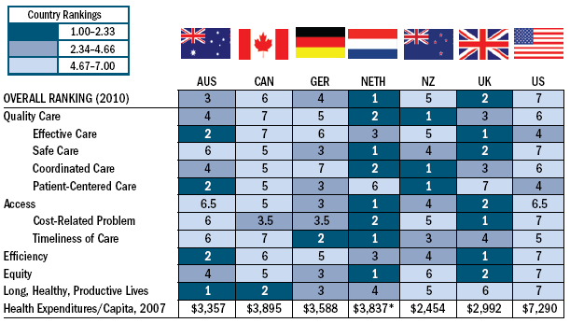
Comparative Health System Performance
Source: the Commonwealth Fund
Notes:
From Davis K, Schoen C, Stremikis K. Mirror, Mirror on the Wall: How the Performance of the U.S. Health Care System Compares Internationally. Update 2010. The Commonwealth Fund.
Life expectancy is not the only measure of health system performance by which the U.S. comes up short. Here are the results of a systematic comparison across 7 countries conducted by the Commonwealth Fund on varioius measures of health system performance, including quality, access, efficiency and equity. As is evident, the U.S. ranks last overall and excels in none of the measures.

Slide 26
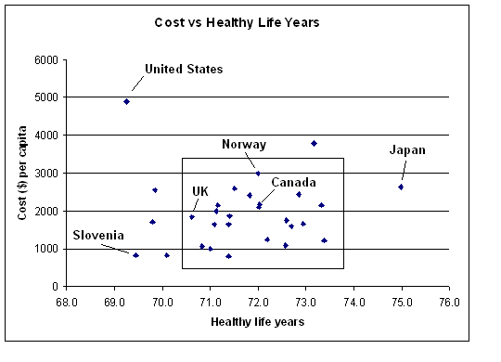
Cost per capita vs healthy life years
Best
Organization for Economic Cooperation and Development data, 2000

Slide 27
How can nutrition professionals…
Reduce health care costs?
Improve population health?
Increase demand and compensations for RDNs & DTRs?

Slide 28
RDN/DTR group Actions
Advocacy: Impact federal, state, and local laws and regulations to support inclusion and payment
Positioning: Demonstrate the value of our participation in care.
Collaboration: Leverage existing and new partnerships
Development: Empower current and future peers to advocate
Resources: Use Academy resources

Slide 29

The Comprehensive Primary Care Initiative: Partnering RDs with Primary Care Practices

Slide 30
Ideas the Academy is promoting
Strengthen primary care (family MD)
Change reimbursement models
Source: the Commonwealth Fund
Notes:
From Davis K, Schoen C, Stremikis K. Mirror, Mirror on the Wall: How the Performance of the U.S. Health Care System Compares Internationally. Update 2010. The Commonwealth Fund.
Life expectancy is not the only measure of health system performance by which the U.S. comes up short. Here are the results of a systematic comparison across 7 countries conducted by the Commonwealth Fund on varioius measures of health system performance, including quality, access, efficiency and equity. As is evident, the U.S. ranks last overall and excels in none of the measures.

Slide 31
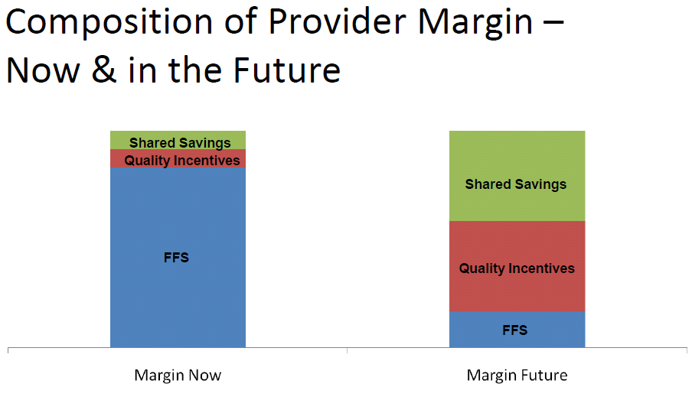
Notes:
This graphic does a great job of showing how providers make money (hospitals, RDs, MDs) now and in the future. One of the challenges we face is having a foot right now in 2 different worlds: FFS vs these types of P4P plans. It’s important to recognize this movement away from FFS to ensure our future success. While this movement scares doctors, and maybe RDs in private practice, I think it positions us well. FFS has not been our friend. P4P could be.
Volume-driven to value-driven

Slide 32
The Evidence
Primary Care Improves Population Health Outcomes
Primary care improves quality and effectiveness.
Primary care decreases costs.
Primary care improves equity.
Multiple outcomes are better in systems with stronger primary care.
NO STUDY SHOWS OTHERWISE

Slide 33
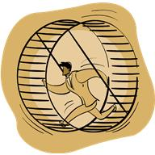
Need for Change – Primary Care View
Primary care clinicians – on a treadmill
  Payment system slanted against primary care, toward procedures, specialists, hospitals
  Very tight financial margin
  Have to see more and more patients to survive
  Can’t deliver the type of care needed
  Need to have other health professionals on their care teams (RDs and RDNs!) but current payment models make this difficult (for both practice & patient)

Slide 34
Why is this Important for the RD?
MNT is linked to improved clinical outcomes and reduced costs related to:
  physician time
  medication use and hospital admissions for people with obesity
  diabetes and disorders of lipid metabolism, as well as other chronic diseases
An RD delivered lifestyle approach to diabetes and obesity improved diverse indicators of health, including:
  Weight
  HbA1c
  Health-related quality of life, use of prescription medications, productivity and total health care costs
  For every dollar invested in the RD-led lifestyle modification program there was a return of $14.58

Slide 35
Why is this Important for the RD and RDN?
The Lewin Group documented an 8.6% reduction in hospital utilization and 16.9% reduction in physician visits associated with MNT for patients with cardiovascular disease.
The group additionally documented a 9.5% reduction in hospital utilization and 23.5% reduction in physician visits when MNT was provided to persons with diabetes mellitus.

Slide 36
Comprehensive
Primary Care Initiative (CPCI)
Providers expected to incorporate “5 functions”
  Care management*
  Enhanced access
  Planned care for chronic conditions & preventive care*
  Patient engagement & proactive patient planning*
  Care coordination across the medical neighborhood*

Slide 37
Screening Questionnaires
This will be hard and fun!

Slide 38
One Minute Essay
What did you learn today that you think will benefit your future practice?
What is one or more questions, from the material, you still wondering about?

